Slide 1
Editing Your Completed Application
Undergraduate Application
Instructions for Ontario High School Students
www.ouac.on.ca/undergrad-guide

Slide 2
After You Have Applied
You can log back in to your application to:
Pay your application fee, if you have not already done so.
Review all the application information you provided to the OUAC.
Make changes to your personal information and program choices (once your fees have been received and processed).
Respond to university offers of admission.

Slide 3
Accessing Your Completed Application
Use the same URL that you used to access the application for the first time: www.ouac.on.ca/undergrad-guide.

Slide 4
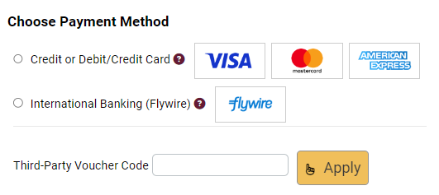
Changing Your Method of Payment
If you chose online banking as your method of payment, you can change to pay by credit or debit card after 1 business day.
Note: During peak times, it can take up to 1 week to process your application once you submit payment. After that time, you can log in to your application to review or make changes.
Notes:
It will take 1-3 business days or up to 1 week during peak times to process your application once you submit payment.

Slide 5
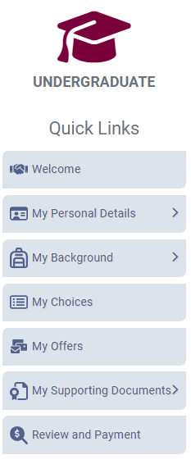
Modifying Your Application
Use the Quick Links menu to navigate between sections.

Slide 6
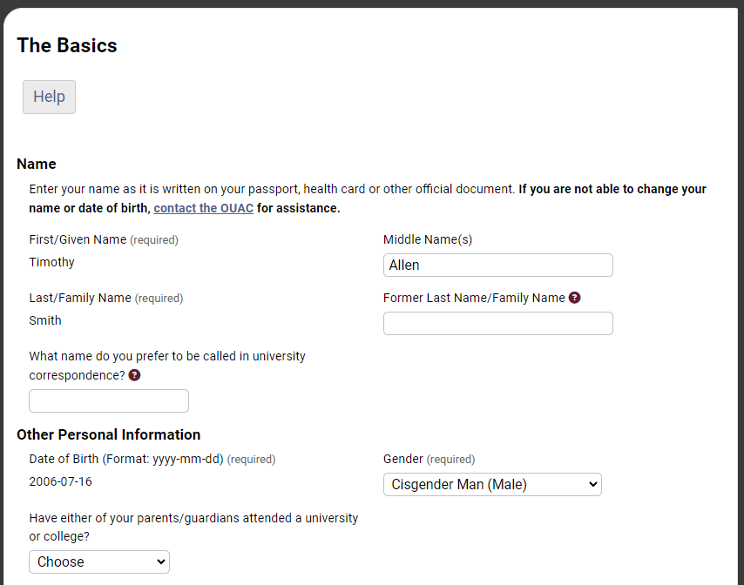
Change Personal and Contact Information (1 of 2)
You are not able to change your first name, last name or date of birth.
If this information needs to be changed, contact us at: undergrad@ouac.on.ca.

Slide 7
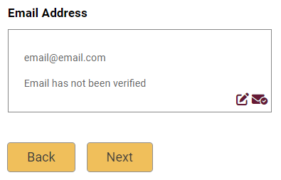
Change Personal and Contact Information (2 of 2)
Verify that your email address is correct. Add your university choices to your email account’s “contact” or “safe senders” list to ensure that all messages are delivered to your inbox.
As you make edits to your application information, be sure to submit all changes.
Notes:
Email is the primary method of communication for the OUAC and the universities.

Slide 8
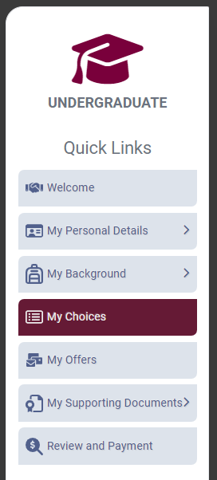
Adding New Programs
Click “My Choices”, select the program you want and enter the program details.
Click “Save Program”.
You will then be returned to the My Choices page.

Slide 9
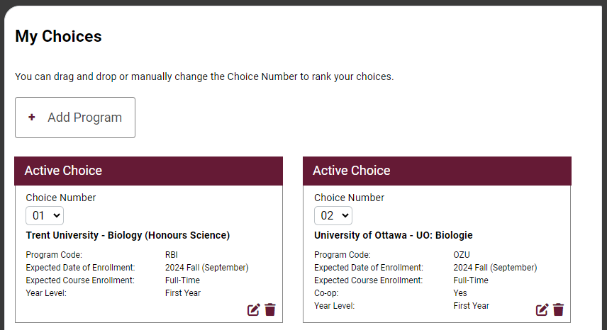
Withdrawing an Existing Choice
Click the trash can icon to withdraw your choice.

Slide 10
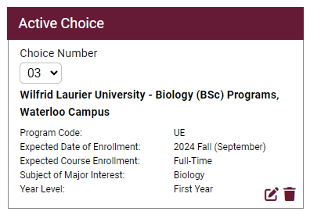
Making Changes to Your Existing Choices
To change details of an existing choice, click the edit icon.
For a university or program choice that is already on your application, you may change only the details that you specified initially.
Note: If you have an active offer or have accepted a university offer of admission, you will not be able to change the program details.

Slide 11
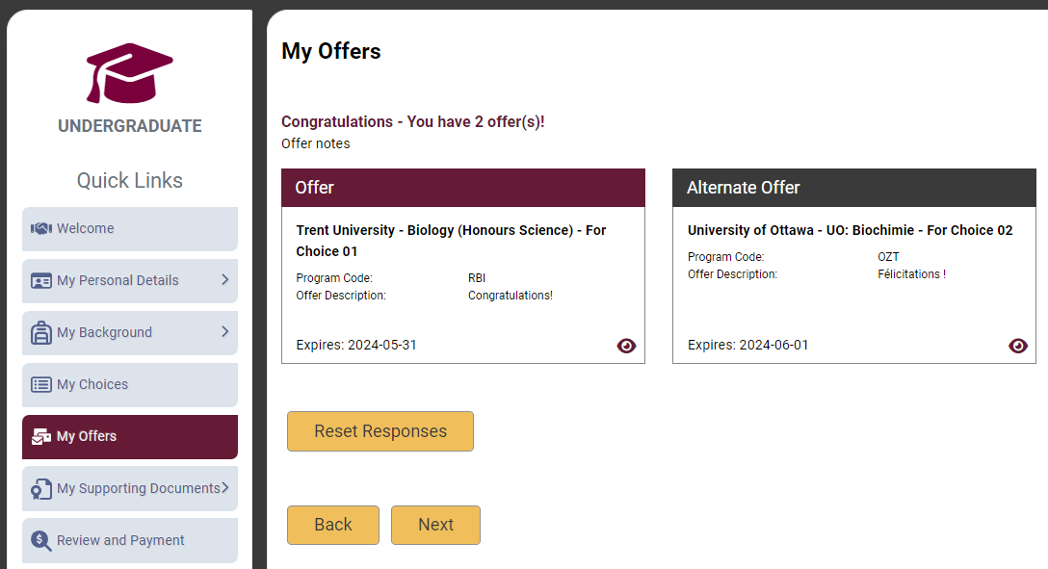
Responding to a University Offer of Admission
To respond to a university offer of admission, click “My Offers” then click the eye icon.
You can choose an offer or alternate offer.

Slide 12
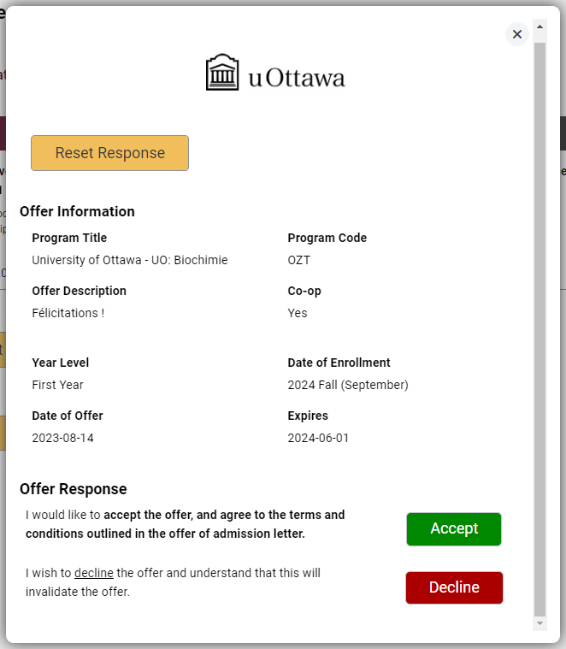
Accept or Decline the Offer
To respond to an offer, click “Accept” or “Decline”.
Notes:
Note: The “Decline” option is not available for all universities.

Slide 13
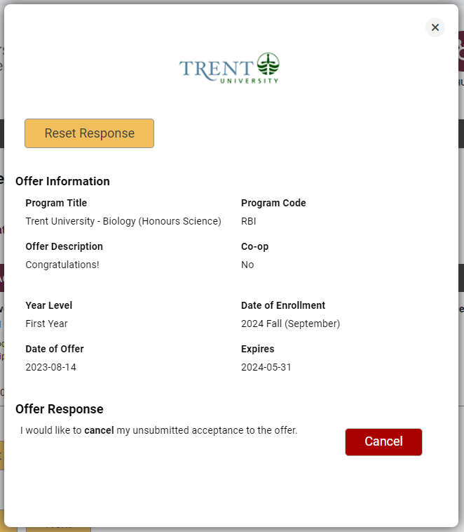
Cancelling an Offer of Admission
To cancel a previously accepted offer of admission, click “Cancel”.
Notes:
Click the “Cancel” icon for the accepted offer on the My Offers page to get to this page, where you can cancel your acceptance of the offer.

Slide 14
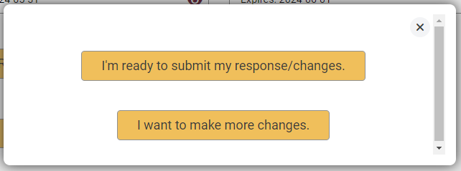
Submitting Responses
You will have 2 options to proceed. Click “I’m ready to submit my response/changes” to proceed to the Review and Payment page or click “I want to make more changes” to make more changes.

Slide 15
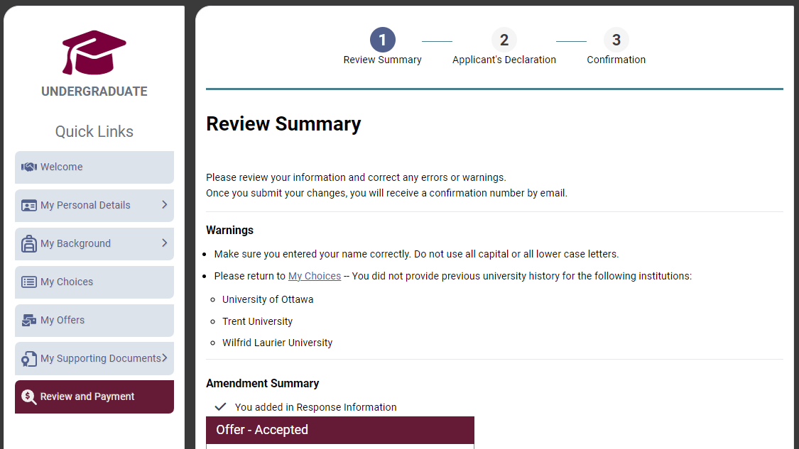
Complete the Review and Payment Process
Click “Review and Payment”.
You must complete this step for the OUAC and the universities to receive your changes and/or responses.
Notes:
There is no fee for submitting a response to an offer of admission.

Slide 16
Finalizing Your Changes
Review your Summary of Changes carefully.
Satisfied with your changes? Click “I Verify and Agree” to continue.

Slide 17
Payment
You must pay for your changes by credit or debit card.
Notes:
There is no charge for submitting a response to an offer of admission.

Slide 18
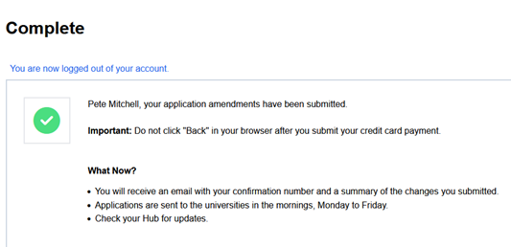
Confirmation of Changes
When you see this screen, it means you have successfully submitted your changes to your application or responses to offers of admission to the OUAC.

Slide 19
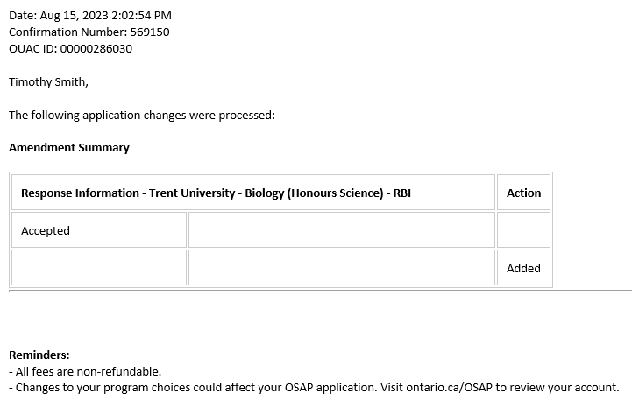
Responses
Log back in to your account after 1 business day to verify your responses and check your email inbox for confirmation of your submitted response.
Note: You will receive only 1 confirmation number by email for all changes or responses to offers made within the same session.

Slide 20
Need Help?
Read the FAQ section on our website at: www.ouac.on.ca/faq.
Contact us:
OUAC 170 Research Lane Guelph ON N1G 5E2
Telephone: 519-823-1063
Fax: 519-823-5232
Email: undergrad@ouac.on.ca
Website: www.ouac.on.ca/undergrad-guide
Notes:
Help with the application is available in several places, including the FAQs section on our website and from Applicant Services. You should refer to the Undergraduate Application Guide available online for important details.
You should also visit OUInfo at www.ontariouniversitiesinfo.ca to find and compare Ontario university programs, and research residences, scholarships, admission requirements and more.

